Slide 1
Introspect
Your thoughts, your device, your control
TEAM: TROUBLESHOOTERS
MEMBERS: David Bautista
Khushi Udupi
Bao Dinh

Slide 2
Introduction
In an era where mental health apps trade user privacy for cloud-driven “insights,” individuals seeking safe self-reflection are left choosing between expensive therapy or insecure platforms.
Introspect bridges this gap by leveraging Retrieval-Augmented Generation (RAG), LLM-powered semantic analysis, and local deep learning embeddings to provide personalized emotional insights—completely offline, ensuring accessibility, trust, and data sovereignty for every user.

Slide 3
Table of contents
01
02
03
04
Innovation & Creativity
Technical Implementation
User Experience
Conclusion

Slide 4
Innovation & Creativity
01
Problem Solved
Cloud-based journaling compromises privacy and limits access to self-reflection tools.
Introspect — an offline, AI-powered journaling app that uses RAG, LLMs, and local embeddings to detect emotional patterns.
02
Solution
03
Innovation
Blends semantic retrieval, contextual summarization, and LLM-based insight generation entirely on-device.
04
Impact
Empowers users to understand their mental health privately and affordably, reducing barriers to self-care

Slide 5
Technical Implementation
Energy Efficiency: On-device inference avoids server farms, cutting cloud-compute emissions.
Hardware Longevity: Lightweight ML pipeline (sentence-transformers + Gemma2-2b) extends usability on low-spec machines.
Sustainable AI Practice: Encourages ethical, decentralized AI adoption.
Roadmap: Add database encryption, voice journaling, mood-trend visualization, and cross-platform low-power builds

Slide 6
User Experience
Clean, distraction-free journaling UI built with Electron + React + Tailwind.
2–5 s local AI analysis → instant pattern insights, no internet needed.
RAG + LLM pipeline recalls emotionally similar entries for self-reflection.
“Offline-proof” demo shows full functionality with Wi-Fi disabled.
Designed for comfort, privacy, and continuity of thought

Slide 7
Conclusion
Scalable Innovation: Built as a modular AI framework—future-ready for RAG, multimodal LLMs, and new data sources.
Continuous Improvement: Fully offline today, but architected to evolve into a hybrid or web-based platform as secure APIs and capital grow.
Startup Potential: Offers a sustainable model—premium encrypted storage, team wellness dashboards, or enterprise mental-health integrations.
Impact Vision: Demonstrates how responsible AI can power human well-being without compromising privacy or trust.
Hackathon Alignment: Exemplifies technology used ethically to create an adaptable, monetizable, and socially conscious solution.

Slide 8
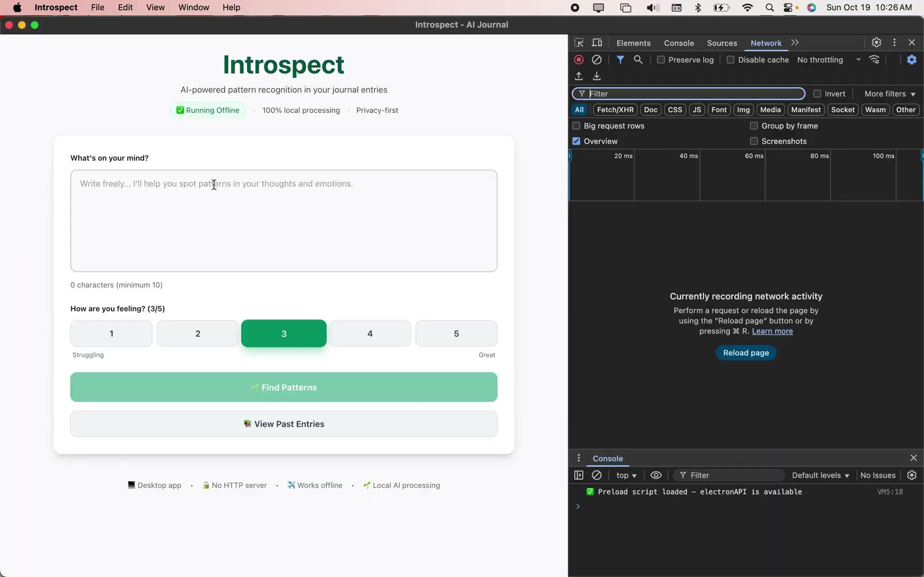

Slide 9

Thanks!
Do you have any questions?
dbautist@charlotte.edu
kudupi@charlotte.edu
bdinh2@charlotte.edu
Github: https://github.com/dbautista15/helpbetter

